Slide 1
Parent reports

Slide 2
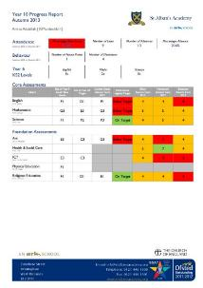
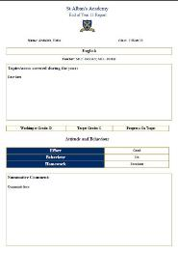
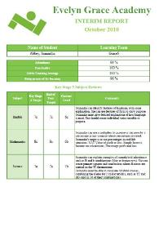
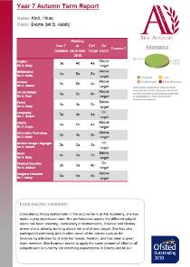
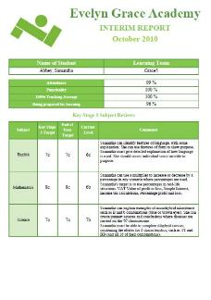
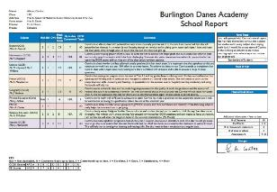
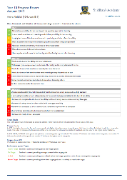
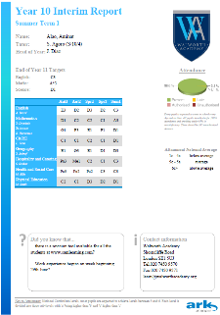
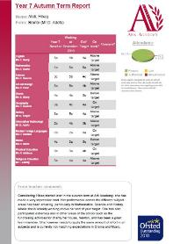
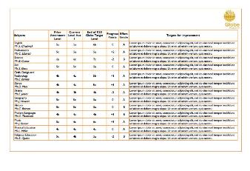
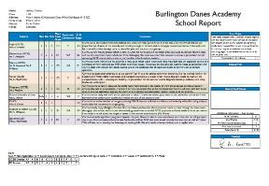
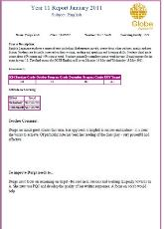
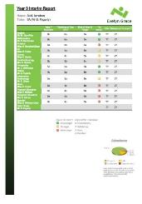
CCR! Parent reports
Notes:
Parent reports, my fauvorite part of CCR. (click click click) Now that we are 27 schools we are litteraly flooded with this. We have to spend a lot of time on their production and maintenance because we haven’t empowered the end users to modify or create them.

Slide 3
CCR! Parent reports - Problems
They are taking too much of our time
They always take the priority
They are always last minute and we cannot plan around them
They are too expensive
Schools cannot modify them, because they are written in PHP
Making them super-flexible actually takes longer than doing the changes, because they are different for every school
Notes:
So when a user submits an RFC, this is discussed and if it is approved, it goes to the implementation queue. (click). This is how it was yesterday, all the pending changes that we have. If you look closely you will see that some of them are very small things .

Slide 4
CCR! Parent reports - Solutions
We discussed last year what could we do to replace them, and we talk about three approaches:
Use the MIS, as every other school
Use something like a mail merge on Word or Excel
Develop a custom bespoke tool for them to be fully customisable on CCR!
1 and 2 were not considered appropriate
3 hasn’t happened because is complex, and requires resources which we don’t have
Notes:
So when a user submits an RFC, this is discussed and if it is approved, it goes to the implementation queue. (click). This is how it was yesterday, all the pending changes that we have. If you look closely you will see that some of them are very small things .

Slide 5
CCR! Parent reports - Solutions
We could have fewer ones but standard
We have set a deadline for changes to parent reports:
This academic year: NEXT FRIDAY 28th FEBRUARY 2014
From next year: End of first term
We want to encourage planning and discourage last minute changes
We want to be able to work on ‘cool’ things
We always think of the kitten
We are going to explore third party options out there
Does anyone know any?
Let’s discuss!
Notes:
So when a user submits an RFC, this is discussed and if it is approved, it goes to the implementation queue. (click). This is how it was yesterday, all the pending changes that we have. If you look closely you will see that some of them are very small things .

